Slide 1
IBM DATA SCIENCE COURSE APPLIED DATA SCIENCE CAPSTONE FINAL REPORT Topic: Using K-mean Clustering To Support Decision Making For Finding The Best Place For Living And Opening A Coffee Shop
Author: Huu-Son Nguyen
Email: huusonbkhcm@gmail.com
Github: https://github.com/huusonbkhcm

Slide 2
Content
INTRODUCTION
DATA PREPROCESSING
METHODOLOGY
RESULTS & DISCUSSION
CONCLUSION
REFERENCE

Slide 3
INTRODUCTION – BACKGROUND
Ho Chi Minh City, Vietnam also commonly referred to as Saigon is the largest city of Vietnam. According to the 2019 census, Ho Chi Minh City has a population of over 8.9 million within city proper and over 21 million within the metropolitan area.
Ho Chi Minh City is the economic and financial Centre of Vietnam, and plays an important role in the country's culture and scientific developments. Ho Chi Minh City is an emerging international tourist destination, with popular landmarks related to the remnants of its colonial past showcased through colonial architecture
With the advantage of geography location as well as the development of economic and travelling, Ho Chi Minh city is one of the best place for foreigners for living and investments.

Slide 4
INTRODUCTION – problems
Tom is one of my best foreigner friend who wants to move to Ho Chi Minh City for living the retired life and also want to open a Café shop in Ho Chi Minh to earn the living cost.
The business problem:
[1] Find the best place which has the same convenient place as his current house in his country to buy a house
[2] collect the data of existing coffee shop in Ho Chi Minh city which can help him to prevent opening the coffee shop at which has many coffee shop nearby.

Slide 5
DATA PREPROCESSING
Data Acquisition: The data is collected at an open source in Github which has the information of the ward and district of Ho Chi Minh City.
In this section, I would like to use some supported code for data processing such as Adding The Latitude and Longitude by call Google Geocode API, Using the Foursquare API to explore the neighborhoods and See the top 5 venues near by HCM, and Exploratory Data Analysis: Find the most Venue Category in Ho Chi Minh City

Slide 6
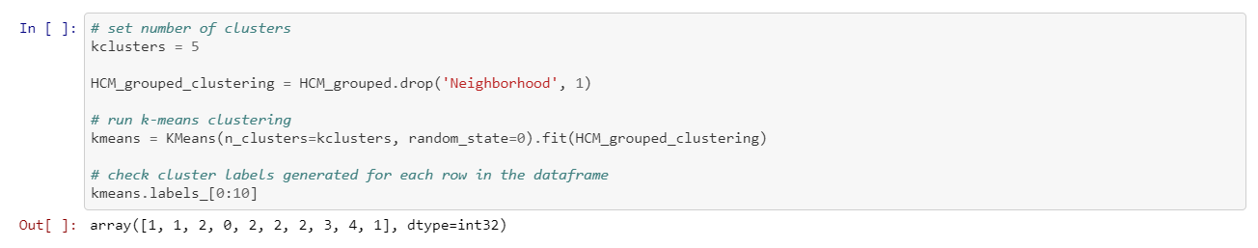
METHODOLOGY
Using K-Mean for clustering the same venues, Set k_clusters = 5, using Scikitlearn Library to solve Clustering problems
Explore the Cafe shop in HCM City, Make the report which area has the most café shop in HCM city, Creating the map which illustrate the existing Café shop in Ho Chi Minh City

Slide 7
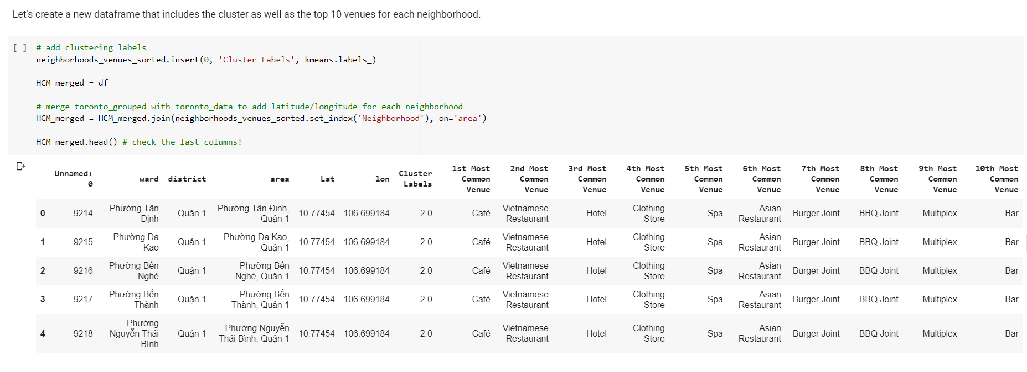
RESULTS & DISCUSSION
Top 10 venues for each neighborhood.

Slide 8
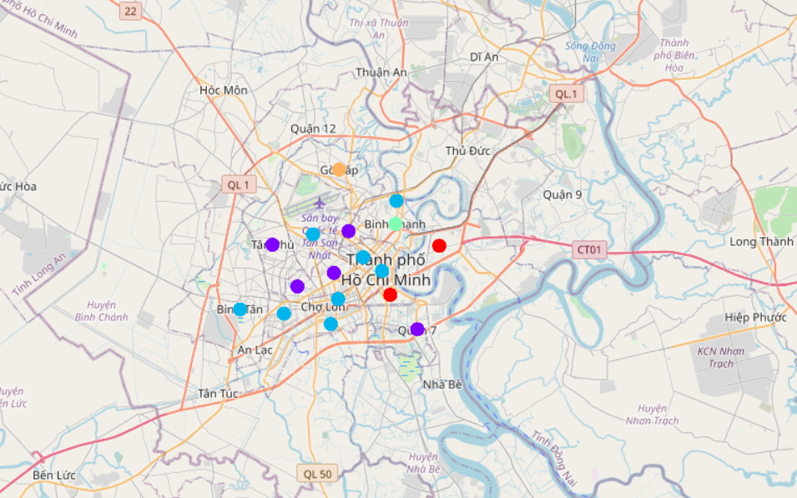
RESULTS & DISCUSSION
Visualization of the resulting clusters.

Slide 9
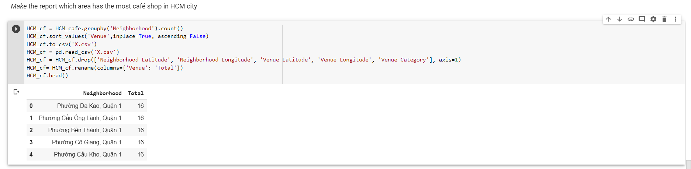
RESULTS & DISCUSSION
Explore the Cafe shop in HCM City:
Make the report which area has the most café shop in HCM city:

Slide 10
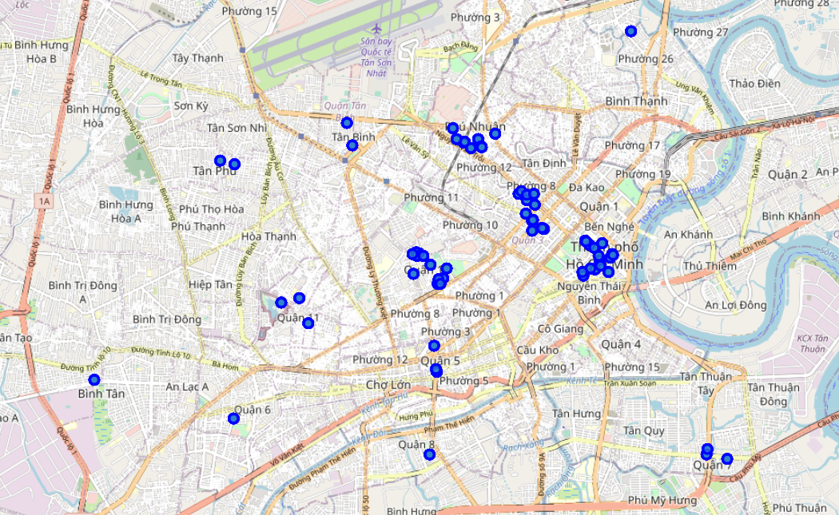
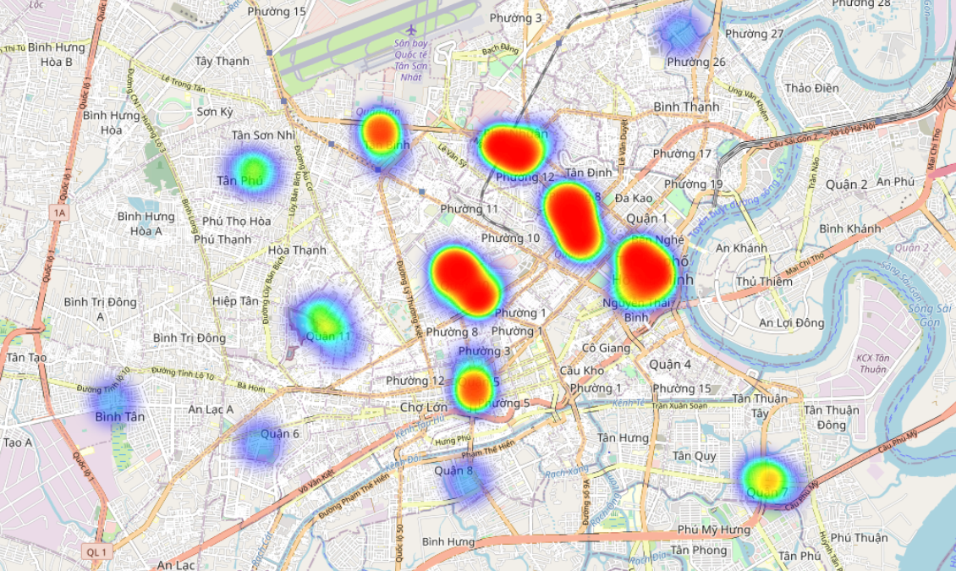
RESULTS & DISCUSSION
Explore the Cafe shop in HCM City:
The map which illustrate the existing Café shop in Ho Chi Minh City
This is some valuable information that Tom can make references for choosing the best place for living and opening the Café shop.

Slide 11
CONCLUSION
In this Project, I already helped Tom to solve his problems such as using K-mean Clustering to find some similar place as his current house for Tom to buy a new house in Ho Chi Minh City.
I also used the EDA to explore which is the most venue in Ho Chi Minh city.
I tried to find the best place for Tom to open the Coffee Shop in Ho Chi Minh City.
The results are valuable references for Tom to consider. I hope that based on found insights, Tom will make a bester decision in the near future.

Slide 12
references
[1] Capstone Project - The Battle of Neighborhoods
https://dev.to/chijade/capstone-project-the-battle-of-neighborhoods-4ha3
[2] Capstone Project — Battle of Neighborhoods in Dong Da District, Ha Noi
https://medium.com/@nguynvnc_45259/capstone-project-battle-of-neighborhoods-in-dong-da-district-ha-noi-66892ec0c9d1
[3] Battle of Neighborhoods in Ho Chi Minh City
https://medium.com/@thanhttrn/battle-of-neighborhoods-in-hochiminh-city-ae85173e61

Slide 13
End. Thank you

